Slide 1
Good and Bad Documents in Engineering
Beatriz Coelho
Instituto Superior Técnico

Slide 2
Outline
Introduction
Bad examples of Documents
Good examples of Documents
Conclusion

Slide 3
Introduction
Writing documents is a key activity for engineers.
The success of communication depends on how the report is written.
This presentation identifies common mistakes and show how to improve them.

Slide 4
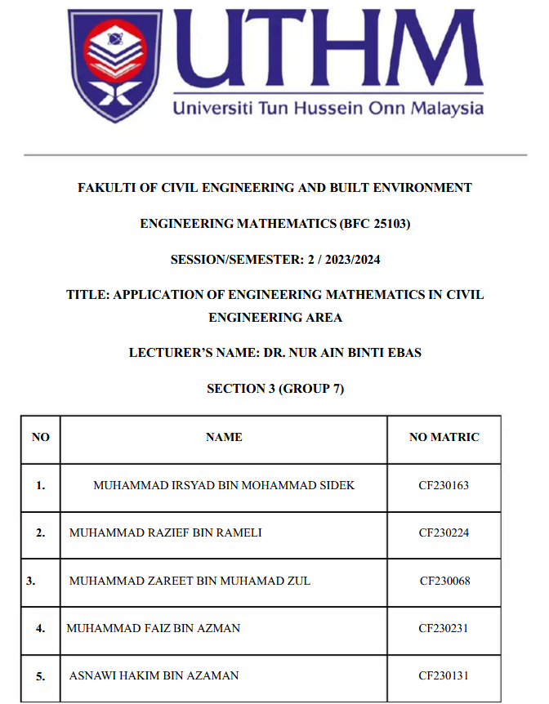
Cover Page – Common Mistakes and Improvements
The title is too general
There is no date or place
There is no submission statement
The list of names is not aligned and looks unprofessional

Slide 5
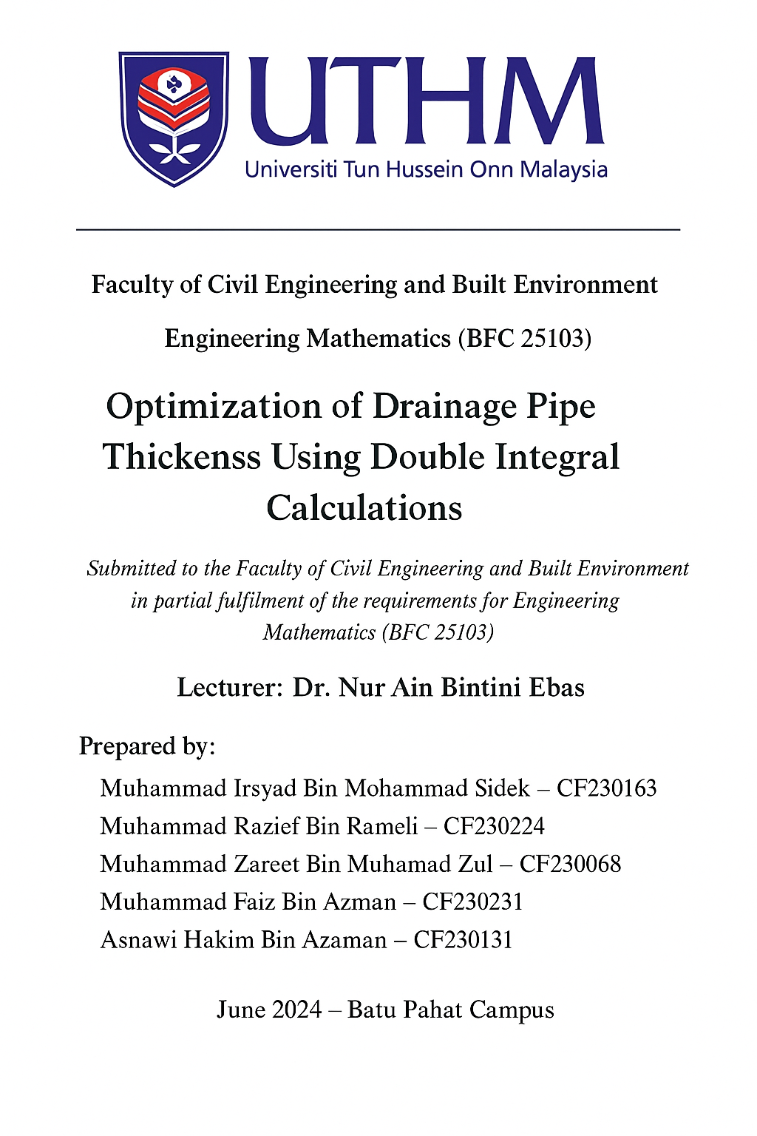
Cover Page – Improvements
Clear and specific title
Complete information
Proper submission statement
Professional layout
Good visual hierarchy

Slide 6
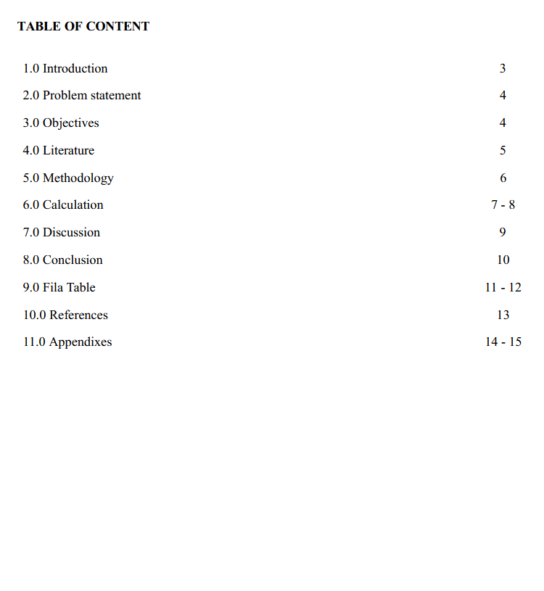
Abstract and Table of Contents – Common Mistakes and Improvements
Missing Abstract
Wrong title – Table of contents
The dots and page numbers are not lined up correctly
Typing error on 9.0
2

Slide 7
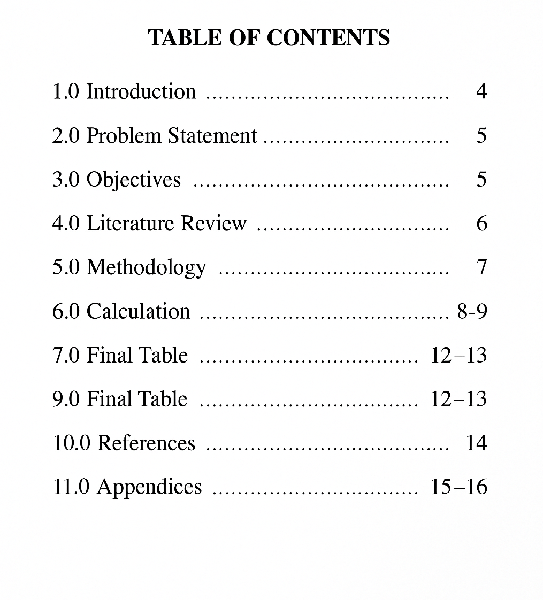
Abstract and Table of Contents –
Improvements
1.0 ABSTRACT
The objective of this report is to determine the optimal thickness of cylindrical drainage pipes to prevent leaks using engineering mathematics.
Double integrals were applied to calculate the volume of the pipes, while an integrated calculation method was used to determine the appropriate pipe thickness for different conditions. The results indicated the required thickness for a water-tight pipe. The integration method proved valuable in analyzing environmental and operational factors.
In conclusion, mathematical integration is an effective tool for optimizing pipe design and ensuring efficient drainage systems
2
3

Slide 8
Introduction – Common Mistakes and Improvements
1.0 Introduction
In engineering, precise mathematical calculations are crucial for designing systems that are both effective and reliable. One such application is in the design and optimization of pipe drainage systems, where the thickness of the pipes plays a significant role in ensuring structural integrity and efficient water flow. Accurate calculations of pipe thickness are essential to prevent leaks, withstand pressure, and accommodate various environmental and operational stresses. The focus of this report is to determine the best choice thickness for drainage pipes using an integrated calculation method. This involves applying advanced mathematical concepts, specifically integration, to calculate and analyze the required pipe thickness for various conditions. Integration allows for the consideration of numerous factors and variables that influence the design, providing a comprehensive and precise solution.
In this study, we explore the use of double integrals to calculate the volume and thickness of cylindrical drainage pipes. The application of these integrals enables us to account for the internal and external pressures, material properties, and flow requirements, ensuring the pipes are designed to meet both safety and efficiency standards. The integration approach not only simplifies complex calculations but also enhances the accuracy and reliability of the results. This report aims to provide a detailed methodology for using integrated calculations to determine pipe thickness, offering valuable insights and practical guidelines for engineers involved in the design and maintenance of drainage systems.
Too long and repetitive
No clear structure
Lacks focus on main goal
4

Slide 9
Introduction – Improvements
1.0 INTRODUCTION
The study focuses on determining the optimal thickness of drainage pipes using principles of engineering mathematics. The thickness of a pipe is a key factor that influences its strength, durability, and resistance to leakage.
Applying mathematical analysis helps engineers design efficient and cost-effective drainage systems.
In this report, double integrals are used to calculate the volume of the pipe and to determine how the thickness affects the overall performance of the structure. The mathematical approach provides a systematic and accurate method for modeling real-world engineering problems.
This report is organized as follows: Section 2 describes the problem statement; Section 3 presents the objectives; Section 4 reviews related studies; Section 5 explains the methodology; Section 6 shows the calculations; Section 7 discusses the results; and Section 8 concludes the findings.
Clear purpose and topic
Logical and organized structure
Explains the method
Connects maths to engineering
4

Slide 10
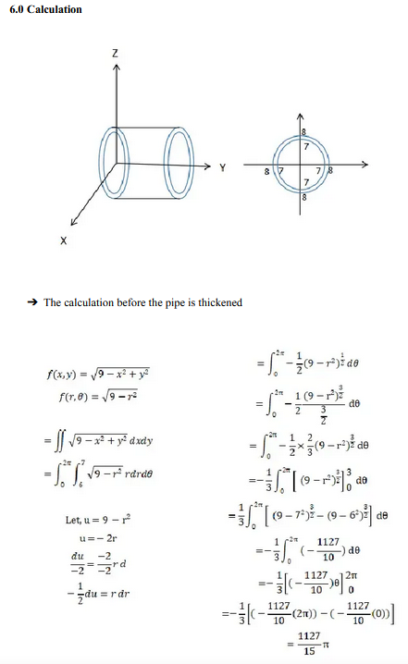
Graphs and Equations – Common Mistakes and Improvements
No explanation before the equations
No units or variables defined
The figures are not labeled or explained.
Lack of structure
4
7

Slide 11
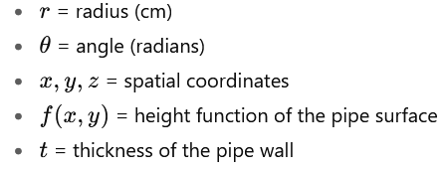
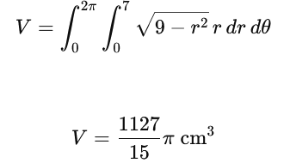
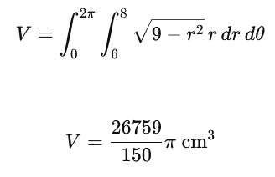
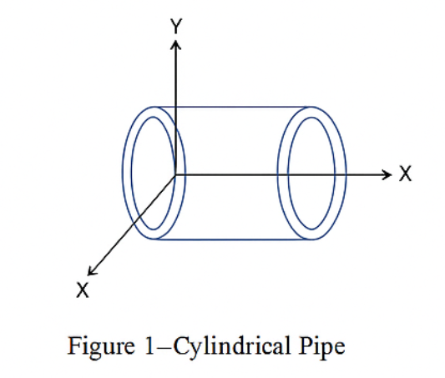
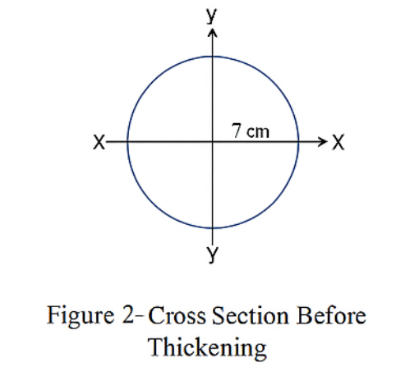
Graphs and Equations – Improvements
6.0 Calculations
The objective of this section is to calculate the volume of the cylindrical pipe before and after the wall thickness is increased. The calculations are based on the use of double integrals in cylindrical coordinates.
Definitions and variables
Explanation before the equations
All variables and units are defined
Figures are labeled
Logical flow and clarity
Results are presented and explained
Calculation of the volume before and after the Pipe is Thickened
The results show that the pipe’s total volume increases significantly when the wall thickness is increased by 1 cm. This demonstrates how small geometric changes in the design have a strong effect on the pipe’s structural performance and water flow capacity.
7

Slide 12
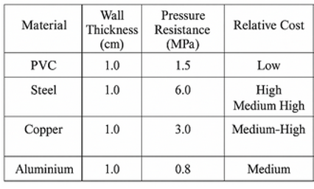
Discussion and tables – Common Mistakes and Improvements
7.0 Discussion
The results obtained from the calculations show that increasing the wall thickness of the pipe by 1 cm leads to a significant improvement in pressure resistance and overall durability.
The mathematical analysis confirmed that a thicker wall can distribute internal stress more evenly, reducing the risk of deformation and leakage during operation.
Table 1 presents a comparison between different pipe materials, considering their wall thickness, pressure resistance, and relative cost.
The data illustrate that while steel and copper can withstand higher pressures, PVC provides the best balance between performance, affordability, and ease of installation.
The increase in the pipe’s total volume after thickening also indicates an improvement in structural capacity, which can be beneficial for drainage systems in residential areas.
However, the material selection should depend on both the expected load and the environmental conditions of use.
Repeats the same ideas
No clear analysis of the table
Does not include a conclusion
8

Slide 13
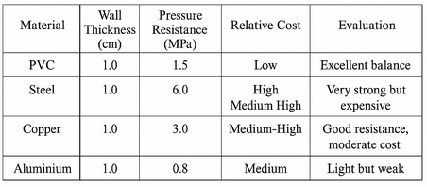
Discussion and tables – Improvements
7.0 Discussion
The results indicate that increasing the pipe wall thickness by 1.0 cm leads to a notable improvement in pressure resistance and overall performance.
The mathematical analysis confirms that a thicker wall can better distribute internal pressure, reducing stress concentration and the risk of leakage during operation.
Table 1 compares four common pipe materials in terms of wall thickness, pressure resistance, cost, and overall evaluation.
As shown, steel and copper can withstand the highest pressures, making them suitable for high-demand systems.
However, PVC offers the best balance between strength, affordability, and ease of installation, which makes it a preferred choice for residential drainage systems.
Although aluminum is lightweight and easy to handle, its low-pressure resistance limits its practical applications.
The results suggest that, for typical drainage systems, PVC provides the most efficient and cost-effective solution, while steel and copper may be more appropriate for industrial or high-pressure environments.
The choice of material should ultimately depend on the expected operating pressure, budget, and maintenance requirements.
Analyses and explains the table data
The table has an “Evaluation” column
Concludes with best material choice (PVC)
8

Slide 14
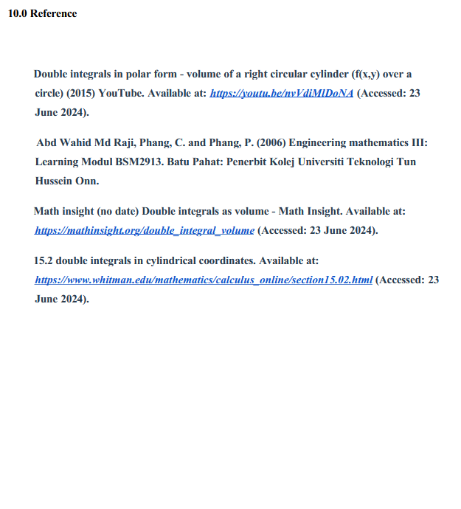
References – Common Mistakes and Improvements
Title should be “References”
Several references included (shows research)
Mix of online and printed sources
Access dates are written
15

Slide 15
Conclusions
A good report is clear, complete, and well structured.
Each section must have a defined purpose and logical order.
Clear writing improves understanding and technical credibility.

Slide 16
Thank you!

